Slide 1
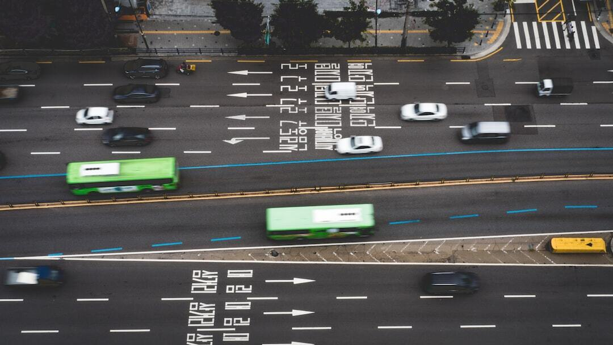
Social DriveNet: Integrating DDQN with Social Attention for Autonomous Traffic Navigation
Introduction: Exploration of enhanced decision-making in dense traffic using advanced reinforcement learning techniques.
Significance: Addresses critical challenges in autonomous driving by improving real-time responses and safety.
Objective: Validate the efficacy of Double Deep Q-Network (DDQN) integrated with social attention for dynamic traffic navigation.
Problem Definition: Dense urban traffic presents a major challenge for autonomous vehicle navigation, requiring highly adaptive and accurate decision-making.
Solution Method: The model utilizes a dual estimator setup to mitigate Q-value overestimations, improving accuracy and stability. Incorporates social attention to dynamically consider the behaviors and positions of surrounding vehicles, enhancing decision-making. Deployed within the 'highway-env' simulation tool, providing a realistic multi-lane highway scenario for testing and development.
Results: The DDQN with social attention showed superior policy optimization and stability in rewards compared to the baseline DQN. Significant improvements in navigation efficiency and safety metrics in dense traffic scenarios. Utilized exponential smoothing and moving averages to demonstrate the robust adaptability and learning efficiency of the DDQN model.
Conclusion: The study validates the effectiveness of integrating DDQN with social attention, marking a significant step in autonomous driving research. Future studies will explore further enhancements in simulation fidelity and the integration of real-world data for more robust models. Continued development in this area has the potential to dramatically improve safety and efficiency in autonomous vehicle navigation.
Photo by Nicki Eliza Schinow on Unsplash

Slide 2
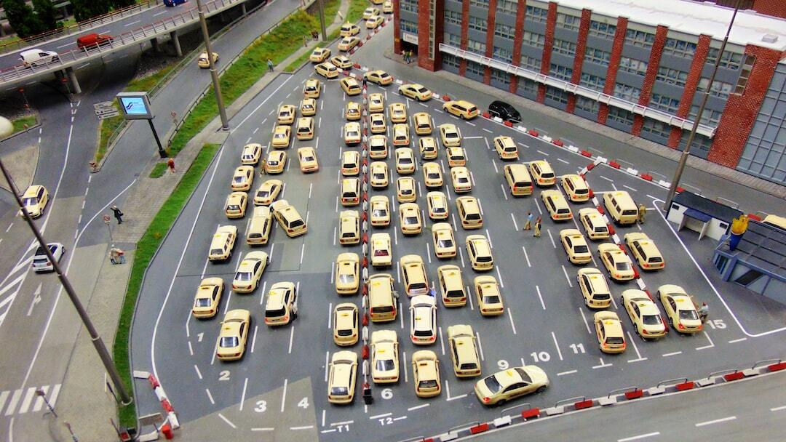
Problem Definition
Traffic Complexity: Dense urban traffic presents a major challenge for autonomous vehicle navigation, requiring highly adaptive and accurate decision-making.
Current Limitations: Traditional models struggle with the dynamic and unpredictable nature of closely-packed urban environments.
Research Motivation: The study explores the potential of Double Deep Q-Networks (DDQN) with social attention to improve traffic navigation accuracy and safety.
Photo by Mika Brandt on Unsplash

Slide 3

Solution Method
DDQN Architecture: The model utilizes a dual estimator setup to mitigate Q-value overestimations, improving accuracy and stability.
Social Attention: Incorporates social attention to dynamically consider the behaviors and positions of surrounding vehicles, enhancing decision-making.
Simulation Environment: Deployed within the 'highway-env' simulation tool, providing a realistic multi-lane highway scenario for testing and development.
Photo by Brett Jordan on Unsplash

Slide 4
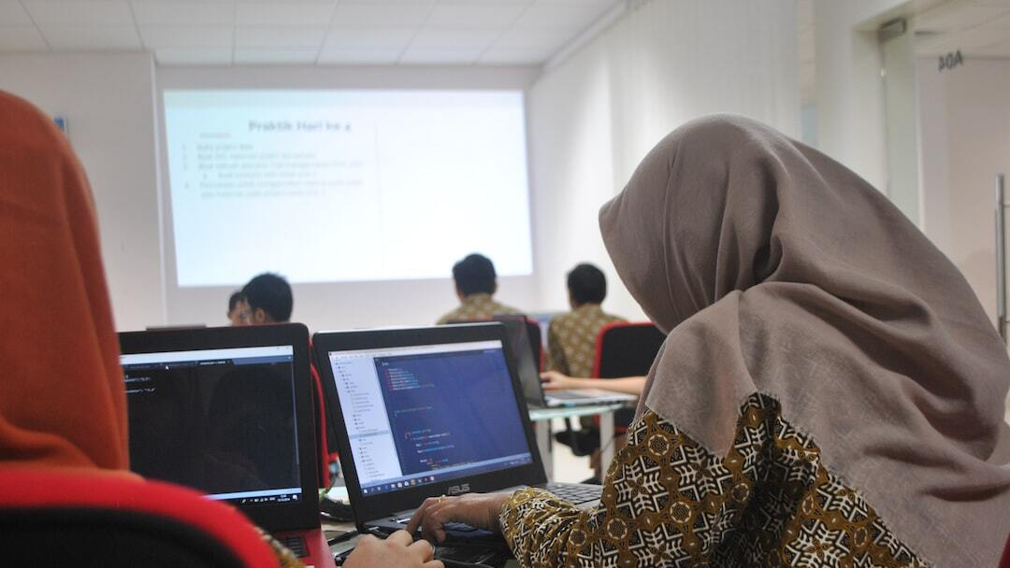
Results
Performance Metrics: The DDQN with social attention showed superior policy optimization and stability in rewards compared to the baseline DQN.
Model Comparison: Significant improvements in navigation efficiency and safety metrics in dense traffic scenarios.
Data Analysis: Utilized exponential smoothing and moving averages to demonstrate the robust adaptability and learning efficiency of the DDQN model.
Photo by FLASHCOM INDONESIA on Unsplash

Slide 5
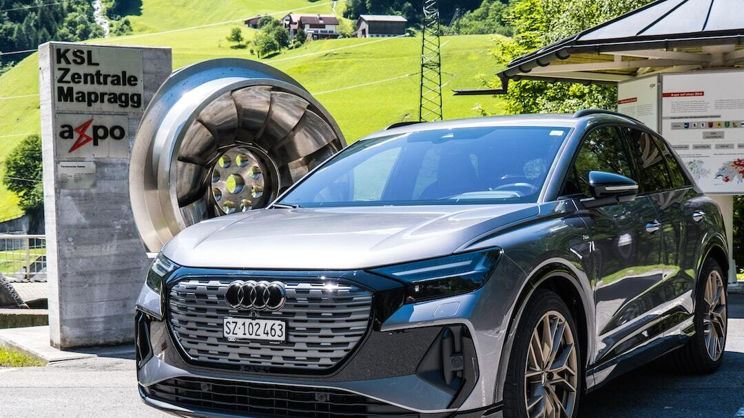
Conclusion and Future Directions
Impact of Findings: The study validates the effectiveness of integrating DDQN with social attention, marking a significant step in autonomous driving research.
Future Research: Future studies will explore further enhancements in simulation fidelity and the integration of real-world data for more robust models.
Technological Advancements: Continued development in this area has the potential to dramatically improve safety and efficiency in autonomous vehicle navigation.
Photo by Matthias Speicher on Unsplash

